Slide 1



Sample Financial
View in Power BI
Last data refresh:
18/07/2023 00:47:08 UTC
Downloaded at:
18/07/2023 00:53:28 UTC

Slide 2
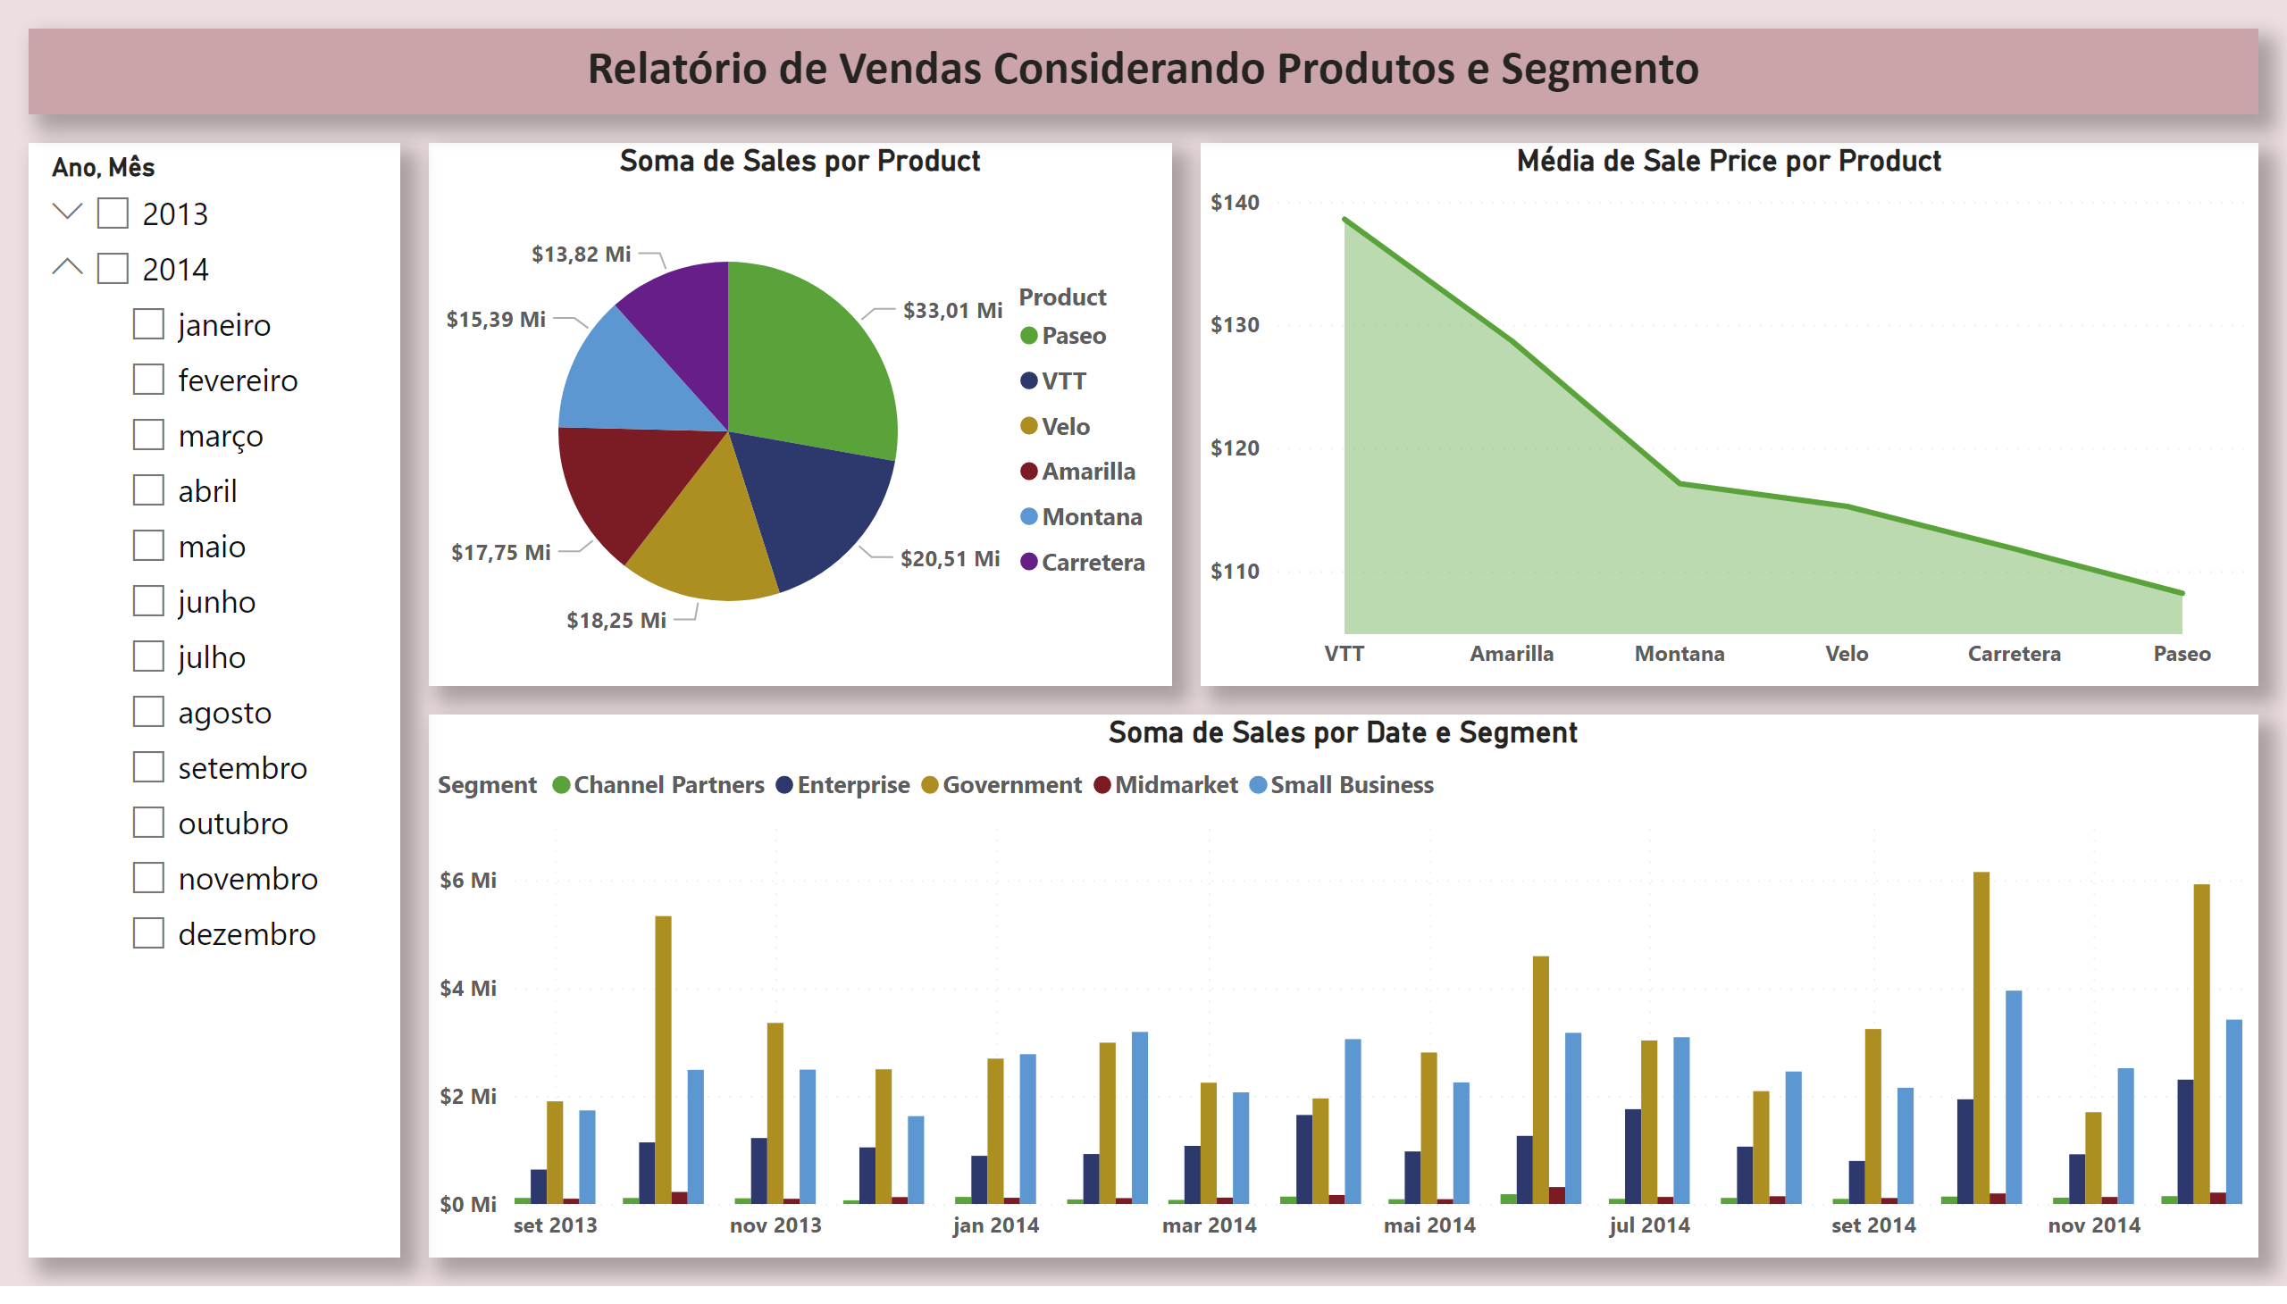
Página 1
Notes:
pieChart
No alt text provided
areaChart
No alt text provided
clusteredColumnChart
No alt text provided
slicer
No alt text provided
textbox
No alt text provided

Slide 3
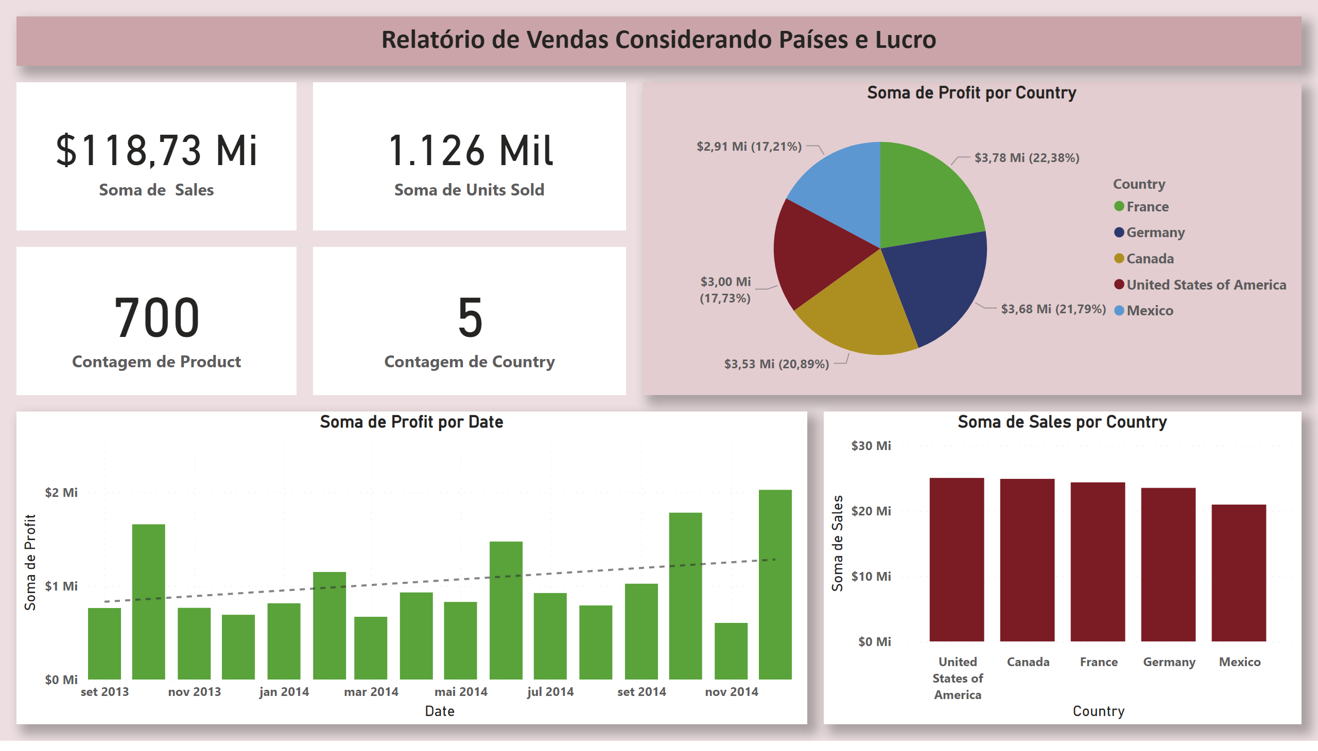
Página 2
Notes:
textbox
No alt text provided
card
No alt text provided
card
No alt text provided
pieChart
No alt text provided
clusteredColumnChart
No alt text provided
clusteredColumnChart
No alt text provided
card
No alt text provided
card
No alt text provided

Slide 4
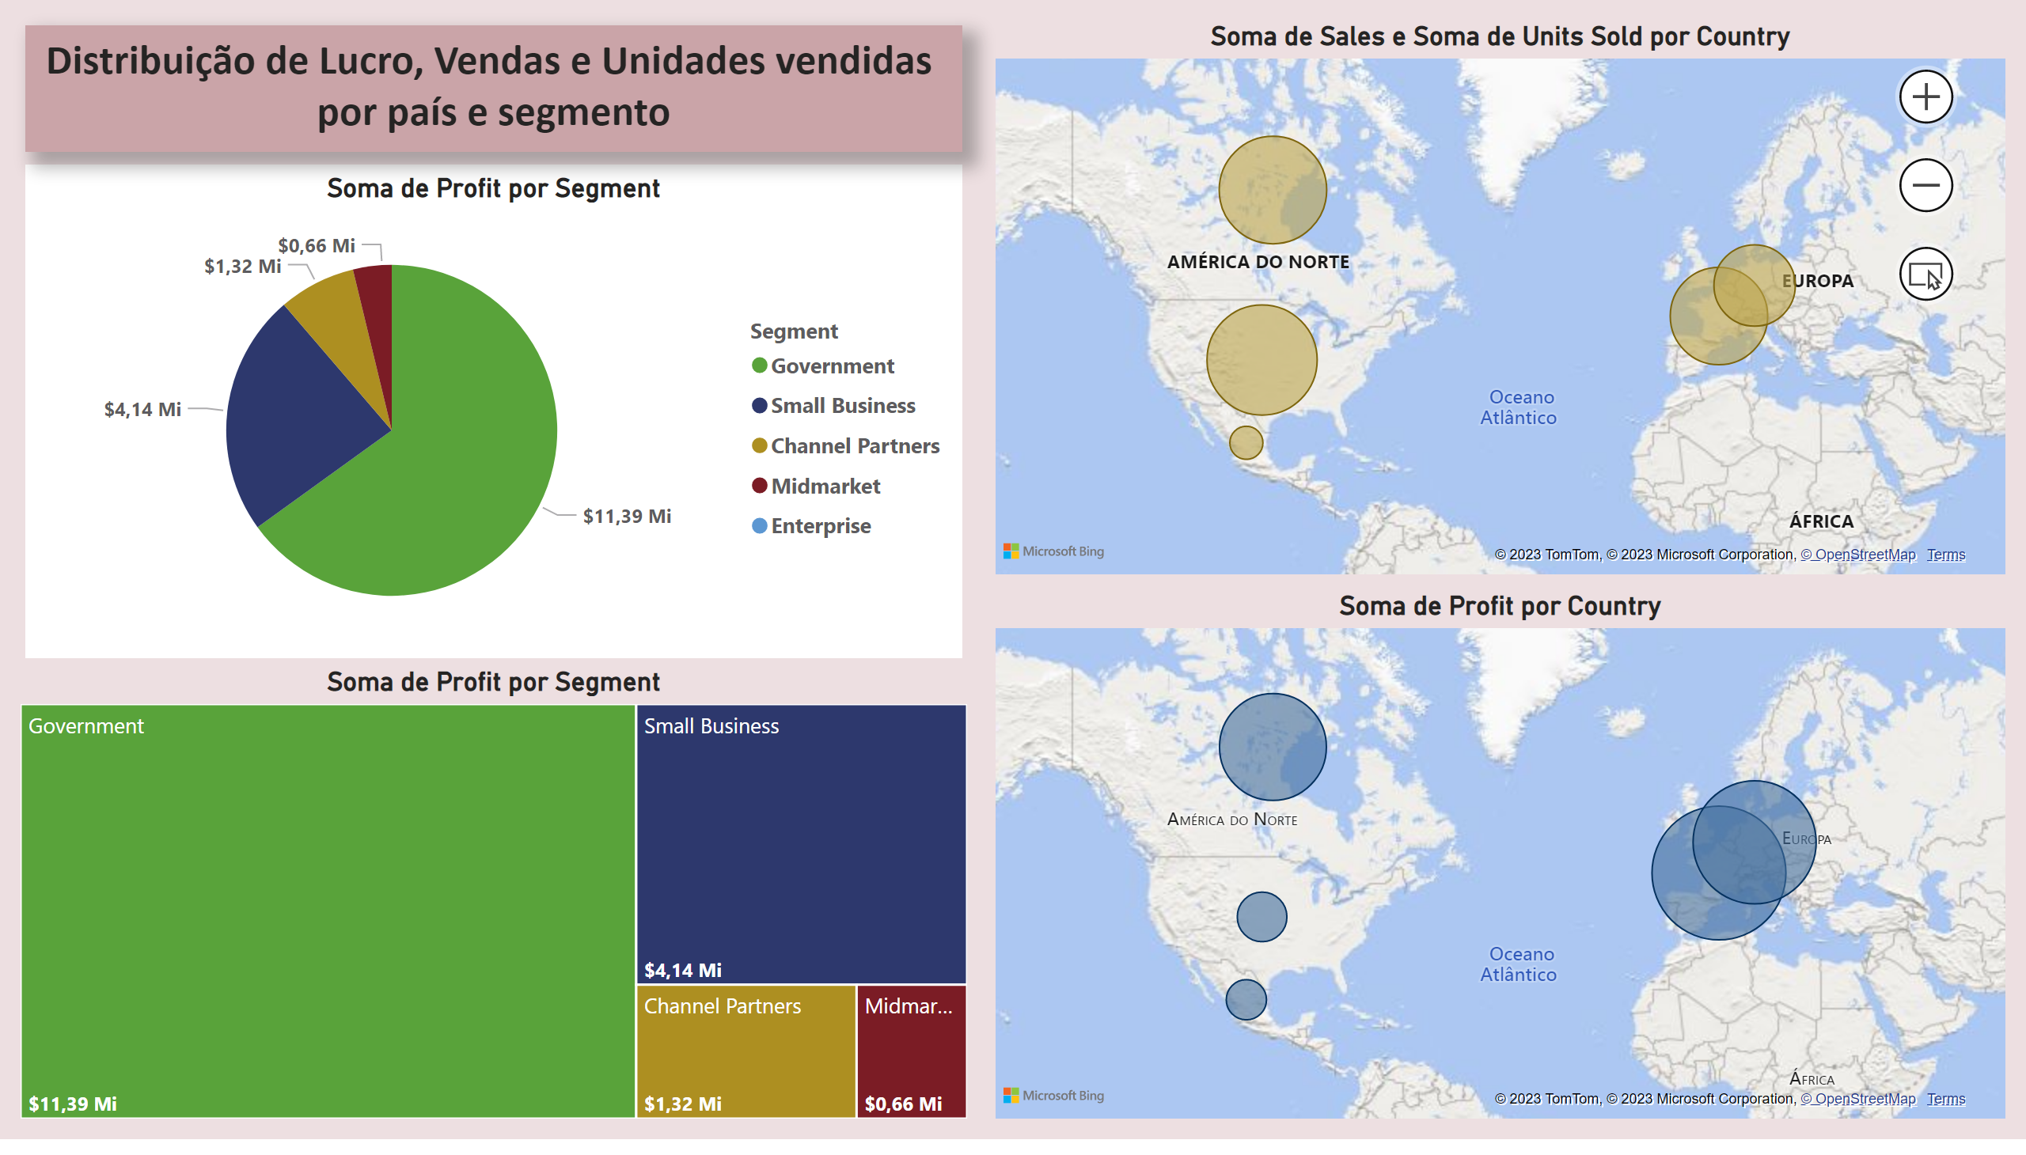
Página 3
Notes:
pieChart
No alt text provided
Soma de Sales e Soma de Units Sold por Country
No alt text provided
map
No alt text provided
textbox
No alt text provided
treemap
No alt text provided

